Slide 1
Gradle

Slide 2
Objectives
Upon completing this session, you should be able to:
Understand how Gradle works.
Understand the differences between Maven and Gradle
Create a Gradle project
Configure a simple build.gradle file
Notes:
Instructor Notes:
Discuss the objectives and the key points that will be covered in this session.

Slide 3

What is a Gradle?
A open source Java-based build automation tool
Requires a recent version of JDK or JRE installed
Main focus is on Java projects
Uses groovy which is actually very similar to Java
Automates the compiling and packaging of projects
Manage project dependencies (Just like Maven)
Allow for the easier setup of project workspace for incoming developers

Slide 4
What is a Gradle?
Gradle is very modular
The base program itself is rather basic
Easy to use and requires no installation if you use the wrapper
This eliminates the problem out having different gradle versions among a team of developers
The wrapper can easily be bundled with the program source code, so it won’t become another dependency a new developer have to manage when setting up a new project environment
Everything else is done by plugins and user generated scripts
Can easily be integrated in any IDE (Eclipse via Marketplace)

Slide 5
What is a Gradle?
At its core, Gradle is just the execution of a series of tasks.
By default, plugins will define a set of tasks
Users can also define their own tasks
All tasks will be executed only once
Tasks can depend on another task – therefore users can easily set the order of the tasks executed
The tasks can be seen as nodes in a Directed Acyclic Graph.

Slide 6
Why use Gradle?
Gradle gives you conventions but still gives you power to override them easily.
Gradle build files are less verbose as they are written in groovy.
It provides very nice DSL (domain-specific language) for writing build tasks.
Has lot of good plugins and vibrant ecosystem

Slide 7

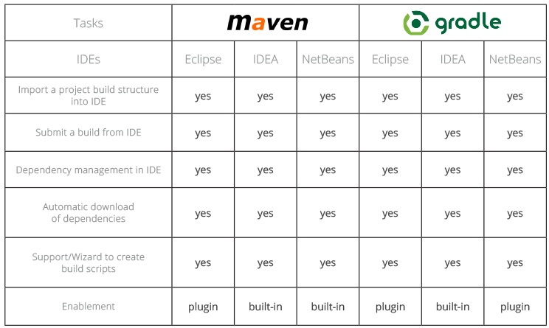
Maven vs Gradle
VS

Slide 8
Maven vs Gradle
VS
Has its own DSL language based on Groovy
Its build script is usually shorter and easier to understand
Convention over configuration
Uses XML
XML tags for build scripts makes it a bit difficult to understand
Can exclude tasks
Flexible
Animation : https://gradle.org/maven-vs-gradle/

Slide 9
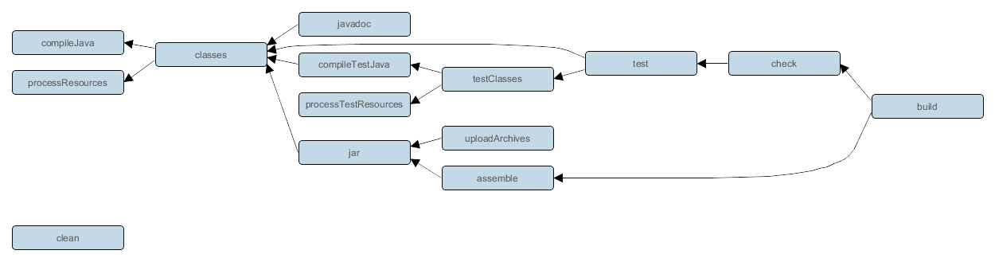
Gradle Java Tasks
Notes:
Browse through the Maven repository to show them the structure

Slide 10
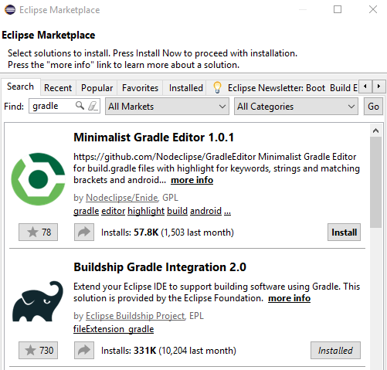
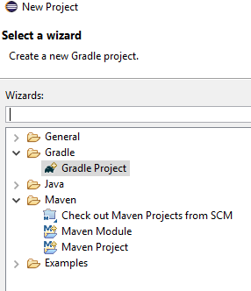
Gradle Installation - IDE
Gradle can be installed and used in any IDE, via the plugin installation
If the IDE does not have the Gradle plugin pre installed, then we can use eclipse marketplace and install it.
Notes:
Browse through the Maven repository to show them the structure

Slide 11
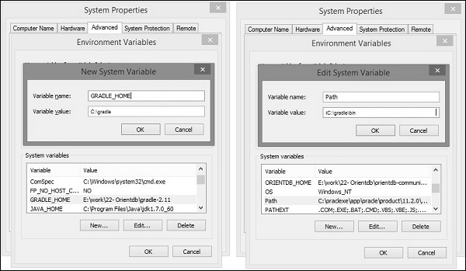
Gradle Installation – For Command Line
Gradle can also be installed (just like maven), by downloading the gradle-version.zip file and unzipping it in a specific location.
Gradle should be inserted in the environment variables in order to be used in command line
To test whether Gradle was correctly set up, in command line simply run : gradle -v

Slide 12
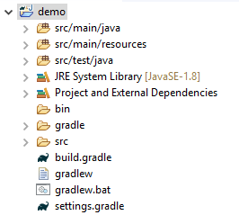
Gradle Project
The structure of a Gradle project is as shown below
The configurations are done in the build.gradle file.

Slide 13
Build.Gradle File
The build.gradle file is the main file, in which the DSL language is written.
It is used to handle 2 main purpose :
Projects
Tasks
A task means a piece of work which a build performs. A task might be compiling some classes, creating a JAR, generating Javadoc, or publishing some archives to a repository.
A project is made of several tasks
Notes:
Browse through the Maven repository to show them the structure

Slide 14
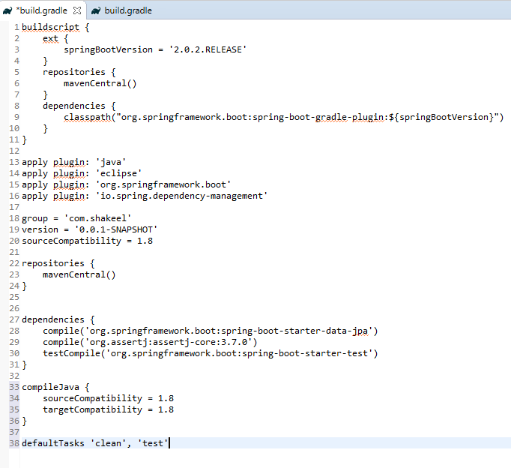
Build.Gradle File - Overview
The groupId and version of our project
The default tasks that should be run when there are no tasks defined

Slide 15


Build.Gradle File – Plugin section
This is the plugin section.
It allows us to add any plugins and thus be able to use default tasks specific to that plugin.
For example : Adding the ‘java’ plugin allows us to use the task ‘compileJava’

Slide 16


Build.Gradle File - Repositories
OR
This is the repositories section.
It allows us to add a central repository from which we can fetch the required plugins.
Other repositories are :
jCenter
Nexus

Slide 17
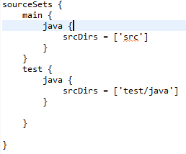
Build.Gradle File – Defining Sources
In this section, we define the sources.
This section is entirely optional as if we do not define it, the java plugin will use the default paths (remember our Gradle project tree in our previous slides)
src/main/java → for our java sources/classes
src/main/resources → for our properties and other resources files.
src/test/java → for our test classes
src/test/resources → for our test resources

Slide 18
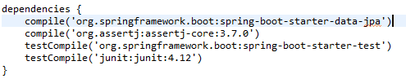
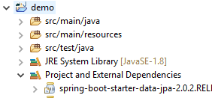
Build.Gradle File – Dependency Management
In this section, we define dependencies.
Just like Maven, we define the groupId, artifactId and optionally the version.
The libraries will we downloaded in our localRepositories.
By default, it uses the location : “C:\Users\#USER\.gradle and is reflected in the library as shown below.
Library in which external libraries can be found

Slide 19
Build.Gradle File – Dependency Management
groupId
artifactId
version
We can define 4 scopes for our libraries
Compile − The dependencies required to compile the production source of the project.
Runtime − The dependencies required by the production classes at runtime. By default, also includes the compile time dependencies.
Test Compile − The dependencies required to compile the test source of the project. By default, it includes compiled production classes and the compile time dependencies.
Test Runtime − The dependencies required to run the tests. By default, it includes runtime and test compile dependencies.

Slide 20

www.menti.com
Code : 963944
Notes:
15 minutes for mini quiz in game form (with points ☺ )

Slide 21


Slide 22
Gradle – Build Scripts/Tasks
Gradle can be executed using command line and the command will look for the build.gradle file
Let us write the following task in our program
task hello {
doLast {
println ‘Accenture Academy’
}
}
To execute it, we simply open command line in our project and execute the following statement :
gradle –q hello
Accenture Academy will be printed in the console.
Notes:
Demo on how to add Maven in environment variables.

Slide 23
Gradle – Build Scripts/Tasks
The previous statement can be simplified further by replacing the doLast statement by the << statement
task hello << {
println ‘Accenture Academy’
}
We use the same gradle command to execute this statement.
We can also use the following
task (hello) << {
println ‘Accenture Academy’
}

Slide 24
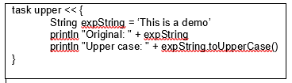
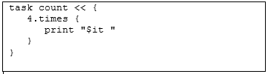
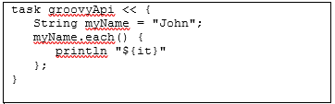
Gradle – Build Scripts/Tasks
Let us run the following scripts in Groovy language and execute them to see the results.

Slide 25

What are the innovative technologies that you think would exist in year 2050
Notes:
15 minutes for mini quiz in game form (with points ☺ )

Slide 26
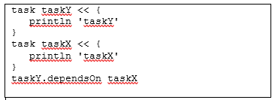
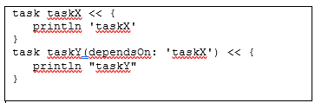
Gradle – Build Scripts/Tasks
We can also add dependencies to tasks.
A dependency to a task means that one task needs to be done first before executing the next task.
For example : Task Y depends on Task X
This means if we launch Task Y using Gradle, it will execute Task X first.
Then it will execute task Y.
Likewise, we can easily couple several tasks together as dependencies.
Below is how we code a task dependency :
When we execute task Y, taskX gets printed first.

Slide 27
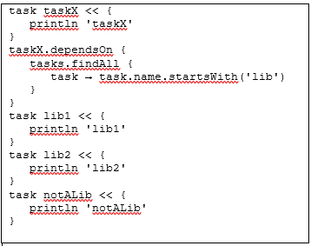
Gradle – Build Scripts/Tasks
Below is a more complex way of defining tasks
What happens if we execute taskX ?

Slide 28
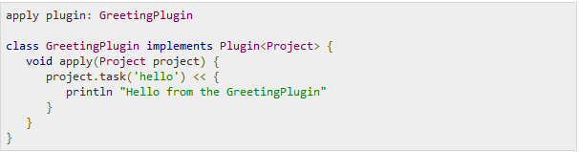
Build.Gradle File – Custom Plugin
We can create custom plugins in which we have a specific task.
When we call a custom plugin, gradle tries to find it and calls it using Plugin.apply() method
When we execute the task found in this plugin, we obtain the result

Slide 29
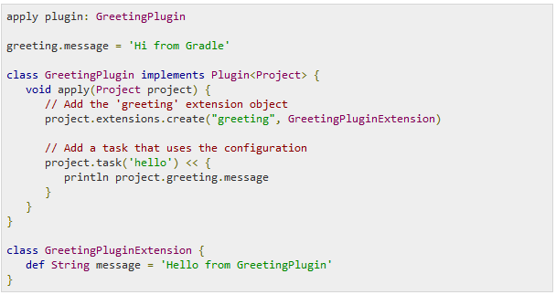
Build.Gradle File – Custom Plugin
What happens when we execute the following lines
We obtain the following results

Slide 30
Gradle – Commands
Some Gradle commands :
gradle clean
gradle tasks
gradle assemble
gradle build

Slide 31
Further Materials (References)
https://www.tutorialspoint.com/gradle/index.htm
http://tutorials.jenkov.com/gradle/gradle-tutorial.html
Notes:
Analysis of these tags

